Slide 1


Exploring Children's Literature
Computational Analysis of Cultural Data
Group 6
Cindy, Francis, Gloria, Lucas

Slide 2


Introduction
Project Focus:
Exploring Children’s Literature as a cultural object.
Research Question: How do sentiment and themes in children’s literature reflect cultural values and societal changes?
Dataset Overview:
Source: Project Gutenberg, ICDL
Content: Metadata, textual content, sentiment, and fact vs. opinion scores

Slide 3
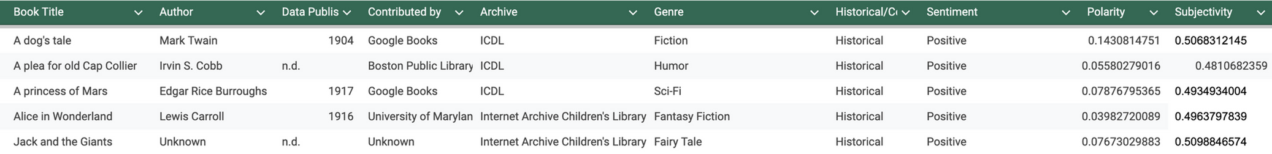
Dataset Demonstration
Key Data Fields:
Title: Name of the book.
Author: Creator of the text.
Sentiment Score: Emotion scale (-1 to +1).
Fact vs. Opinion Score: Narrative style (0 factual, up to 1 opinion-based).
Creation Process:
Collected .txt files from Project Gutenberg and ICDL.
Cleaned data with Python (punctuation removal, normalization).
Transformed raw data into structured .csv.
Challenges:
Ensuring consistent metadata.
Transitioning from text to structured format.

Slide 4
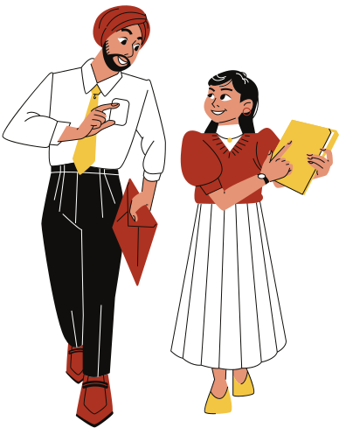
Experimentation Results
Insights Gained:
Positive Sentiment: Most books show uplifting tones, consistent with children’s literature goals.
Moderate Subjectivity: Balance of emotional storytelling and factual content.
Example Visualization (Planned):
Bar charts for sentiment distribution over time, and visualizations to explore other correlations.

Slide 5
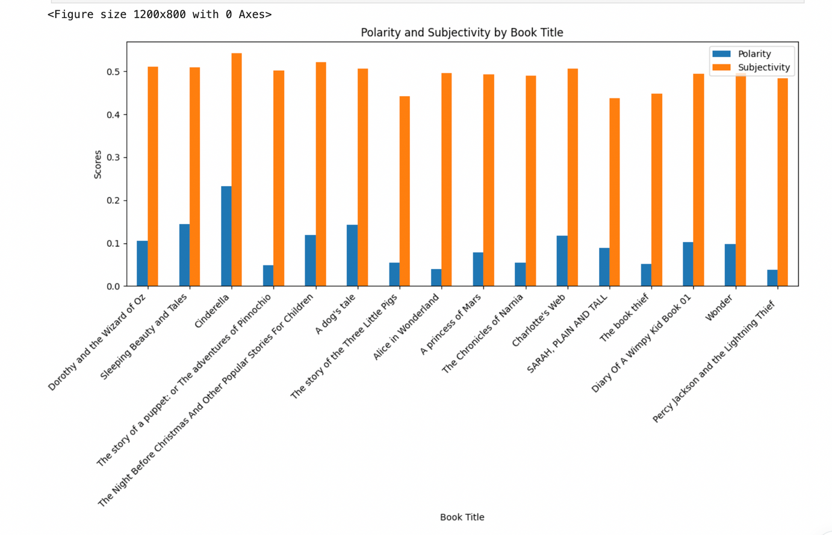
Experimentation Results

Slide 6
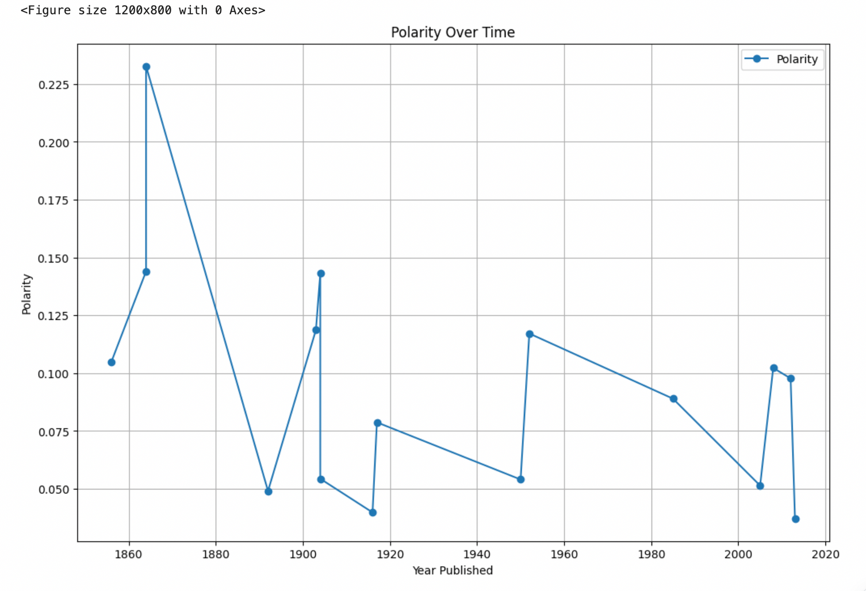
Experimentation Results

Slide 7
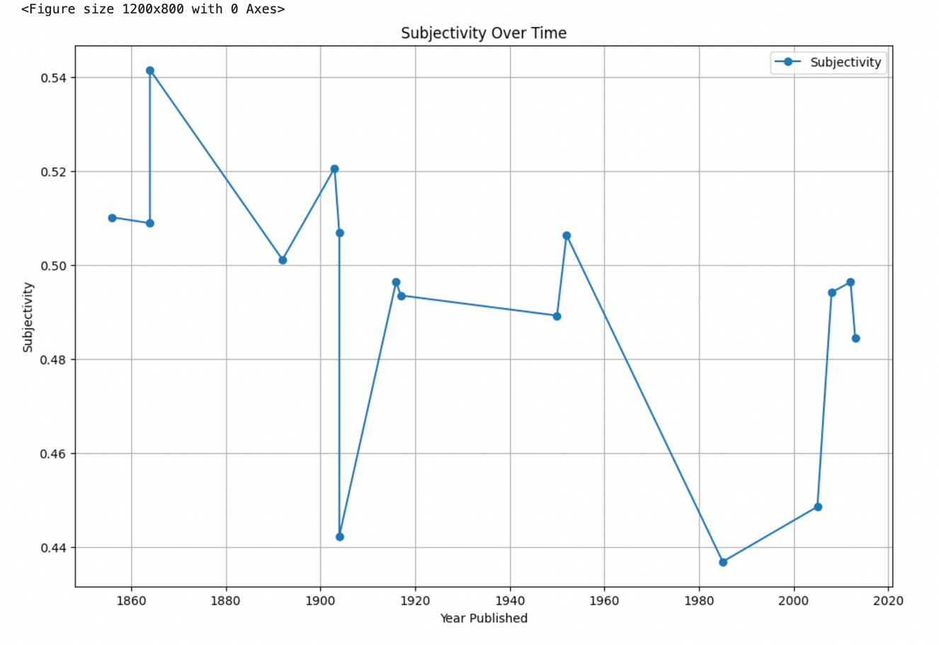
Experimentation Results

Slide 8





Reflection
Lessons Learned:
•Importance of careful data preparation.
•Collaboration facilitated task division and problem-solving.
•Challenges:
•Metadata inconsistencies.
•Time constraints for dataset refinement.
•Solutions:
•Clear delegation of roles.
•Regular team communication.
Future Directions
•Expand Dataset: Include more genres and time periods.
•Refine Methods: Apply advanced sentiment analysis tools and incorporate additional computational techniques.
•Visualization: Develop charts and other visuals to effectively communicate trends.

Slide 9

Thank You for Listening!

